Slide 1

Deep Neural Networks
(AIML ZG565)
DNN Team

Slide 2
The author of this deck, Prof. Seetha Parameswaran, is gratefully acknowledging the authors who made their course materials freely available online.

Slide 3
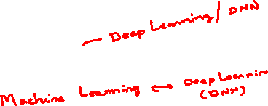
Course Logistics

Slide 4
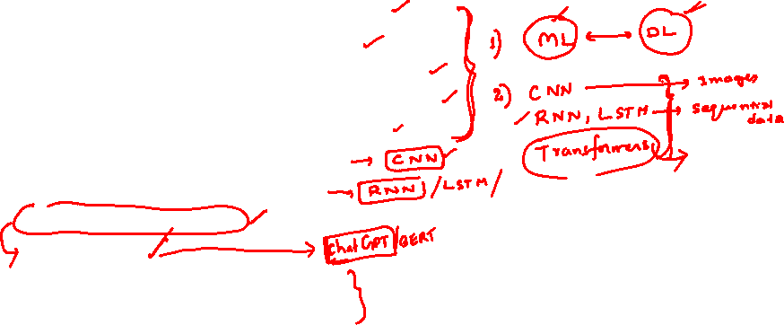
What we Learn…. (Module Structure)
Deep learning - What, Why, where
Artificial Neuron and Perceptron
Linear Neural Network for Regression
Linear Neural Network for Classification
Deep Feedforward Neural Network
Convolutional Neural Network
Recurrent Neural Networks
Attention Mechanism
Transformer
Optimization of Deep models
Regularization for Deep models
Notes:
Talk about each topic in 1 or 2 sentences.

Slide 5
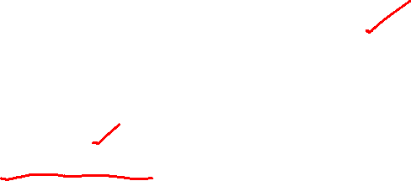
Books
Text book
Dive into Deep Learning by Aston Zhang, Zack C. Lipton, Mu Li, Alex J. Smola. https://d2l.ai/chapter_introduction/index.html
Reference book
Deep Learning by Ian Goodfellow, Yoshua Bengio, Aaron Courville https://www.deeplearningbook.org/
Notes:
The text book is freely available for download

Slide 6
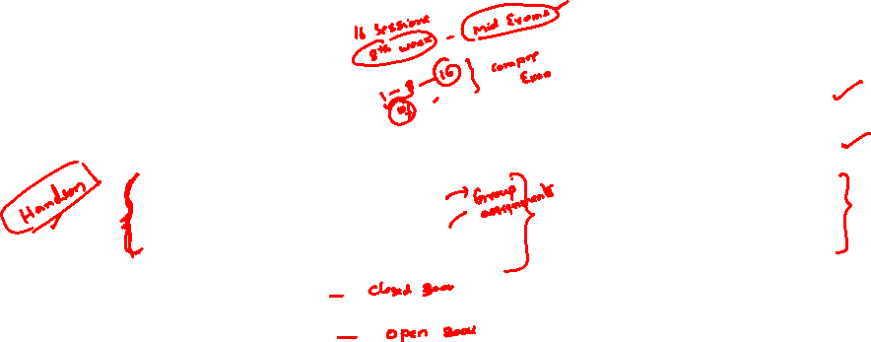
Evaluation Components and Schedule
Component | Name | Weightage | Type
EC 1 | Quiz I | 5 % | Pre-midsem
 | Quiz II | 5 % | Post-midsem
 | Practice Lab Assignment I | 10 % | Pre-midsem
 | Situated Learning Assignment II | 10 % | Post-midsem
EC 2 | Mid sem Exam | 30 % | Sessions 1-8
EC 3 | Compre Exam | 40 % | Sessions 1 -16
EC1 = Quiz I + Quiz II + Assignment I + Assignment II

Slide 7
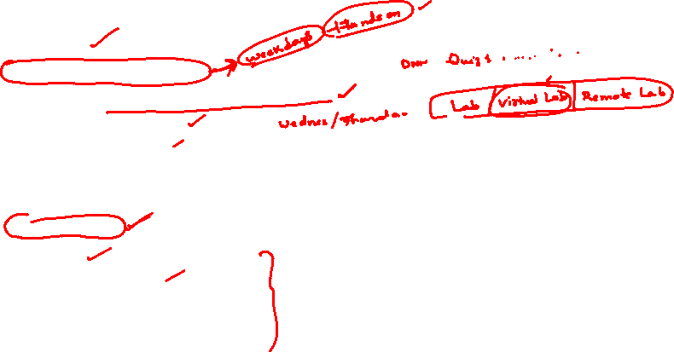
Course Logistics
Refer Taxila for the following
  Handout
  Schedule for Webinar
  Schedule of Quiz, and Assignments.
  Session Slide Deck
  Demo Lab Sheets
  Quiz-I, Quiz-II
  Assignment-I, Assignment-II
  Sample QPs
Virtual Lab
  Practice lab sheets
Lecture Recordings
  Available on Microsoft teams
Notes:
Instruct the students to follow Taxila announcements for updates. Instruct that the IC will be responsible for answering all queries regarding the course.

Slide 8
Honour Code
All submissions for graded components must be the result of your original effort. It is strictly prohibited to copy and paste verbatim from any sources, whether online or from your peers. The use of unauthorized sources or materials, as well as collusion or unauthorized collaboration to gain an unfair advantage, is also strictly prohibited. Please note that we will not distinguish between the person sharing their resources and the one receiving them for plagiarism, and the consequences will apply to both parties equally.
In cases where suspicious circumstances arise, such as identical verbatim answers or a significant overlap of unreasonable similarities in a set of submissions, will be investigated, and severe punishments will be imposed on all those found guilty of plagiarism.

Slide 9

In case of Queries regarding the course….
Step 1: Post in the discussion forum.
Read through the existing post and if you find any topic similar to your concern, add on to the existing discussion.
Avoid duplication of queries or issues.
Step 2: Email to the IC at seetha.p@pilani.bits-pilani.ac.in if the query or issue is not resolved within 1 weeks time. Turn around for response to the email is 48hrs.
In the subject pl mention the phrase ”DNN” clearly.
Use BITS email id for correspondence. Emails from personal emails will be ignored without any reply.
PATIENCE is highly APPRECIATED :)
Notes:
Iterate that the IC will be responsible for answering all queries regarding the course.

Slide 10
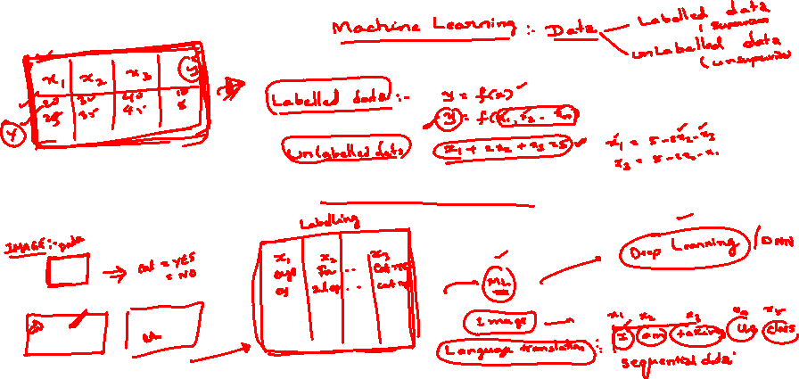
What is Deep Learning?

Slide 11
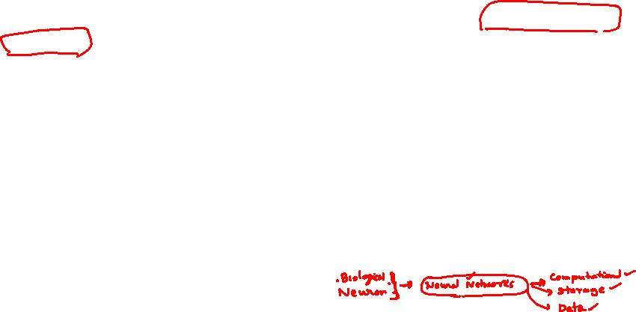
Definitions of Deep Learning
Deep Learning is a type of machine learning based on artificial neural networks in which multiple layers of processing are used to extract progressively higher level features from data.
Deep learning is a method in artificial intelligence (AI) that teaches computers to process data in a way that is inspired by the human brain.
Deep learning is a machine learning technique that teaches computers to do what comes naturally to humans: learn by example.
Deep learning is a subset of machine learning, which is essentially a neural network with three or more layers.
Deep Learning gets its name from the fact that we add more "Layers" to learn from the data.

Slide 12
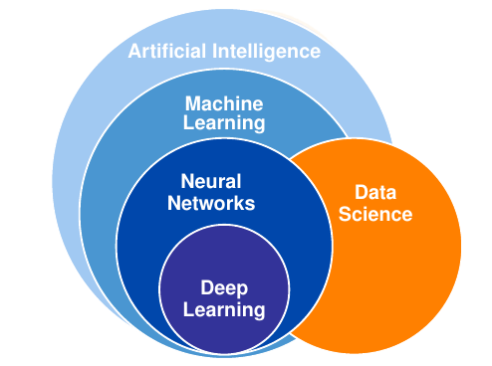
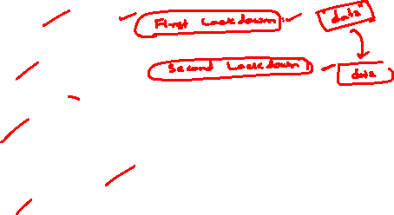
Where in AI sits DL?
AI is a general field that encompasses machine learning and deep learning, but that also includes many more approaches that don’t involve any learning.

Slide 13

AI - ML - DL
AI : Artificial intelligence is the science of making things smart. The aim is make machines perform human tasks. Eg: Robot cleaning a room.
ML : Machine learning is an approach to AI. The machine learns or perform tasks through learning by experience.
DL : Deep Learning is a technique for implementing machine learning to recognise patterns.

Slide 14
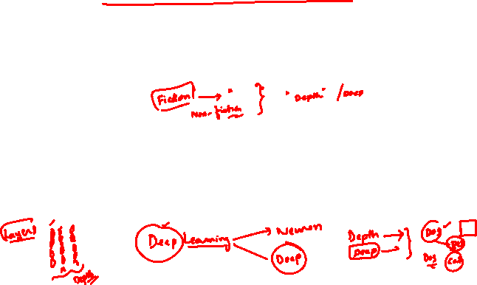
Deep (Machine) Learning
Deep learning is a specific subfield of machine learning.
Learning representations from data that puts an emphasis on learning successive layers of increasingly meaningful representations.
The deep in deep learning stands for this idea of successive layers of representations.
The number of layers that contribute to model the data is called the depth of the model.
In deep learning, the layered representations are learned via models called neural networks, structured in literal layers stacked on top of each other.

Slide 15
Why Deep Learning?

Slide 16
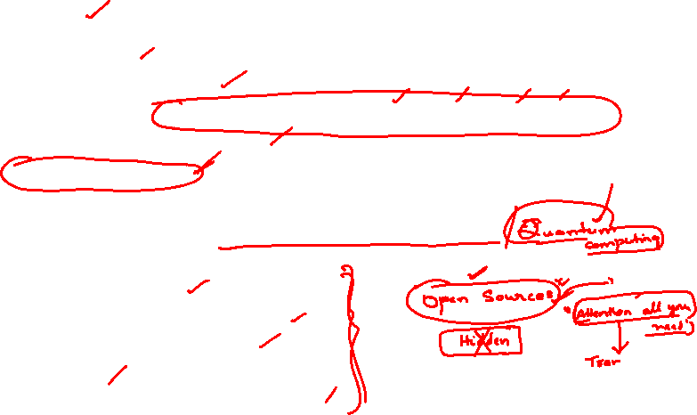
Why Deep Learning?
Data and Storage
  Large amounts of data
  Lots and lots of unstructured data like images, text, audio, video
  Cheap, high-quality sensors
  Cheap data storage
Computation
  Cheap computation - CPU, GPU, Distributed clusters
Algorithms
  Learn by examples
  Automated feature generation
  Better learning capabilities
  Scalability
  Advance analytics can be applied

Slide 17
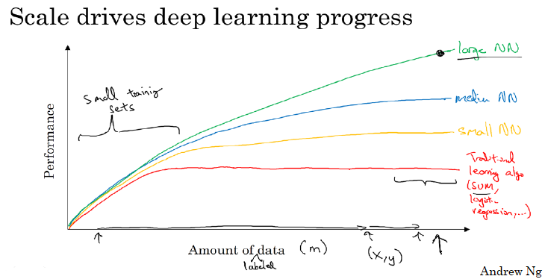
Why deep learning?
Notes:
As the amount of data grows, traditional learning algo do not give better performance. Larger (means deeper) the NN, better the performance, as the amount of data grows.

Slide 18
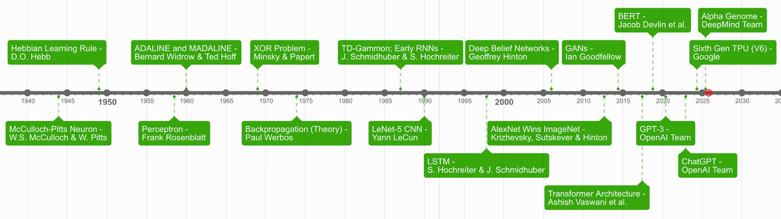
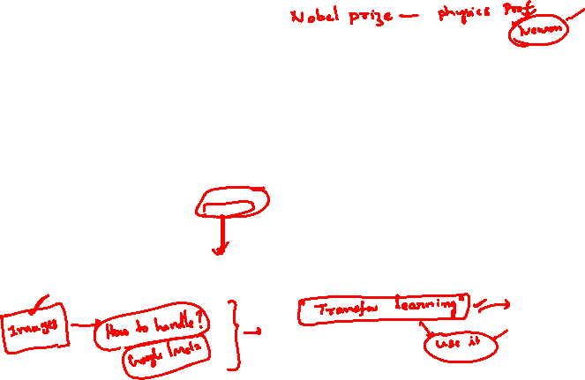
Deep Learning Timeline

Slide 19
Applications of Deep Learning

Slide 20
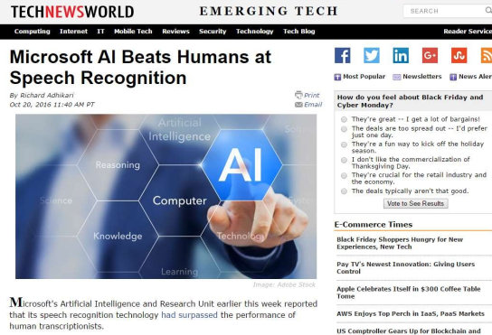
Breakthroughs with Neural Networks
Notes:
Speech recognition using DNN. explain wake word like Alexa, Siri recognition where speech is the input and the app is responding to the query.

Slide 21
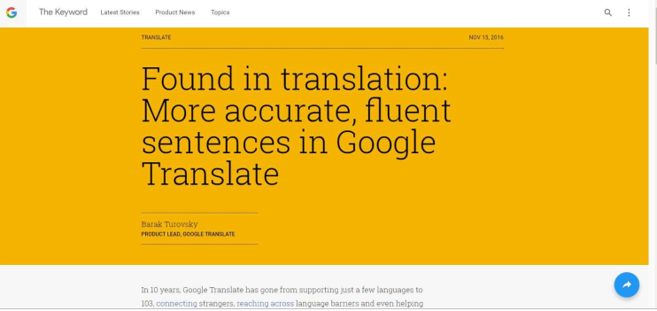
Breakthroughs with Neural Networks
Notes:
Translation of text from natural language to another where the input is textual and

Slide 22
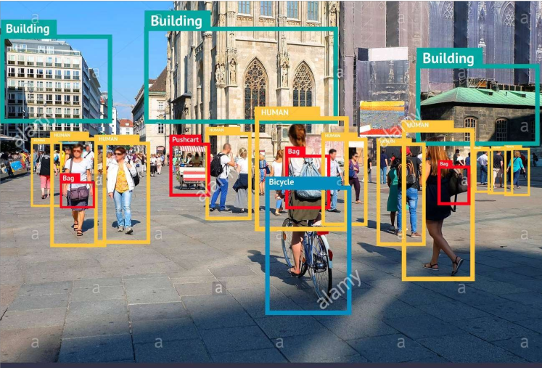
Breakthroughs with Neural Networks
Notes:
Identifying and recognizing various objects in an image. The input is image. OBJECT RECOGNITION

Slide 23
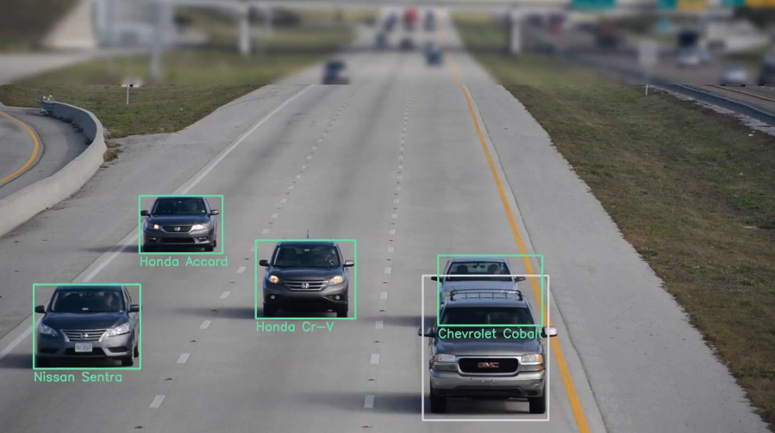
Breakthroughs with Neural Networks
Notes:
Multi object recognition or object with in object.

Slide 24
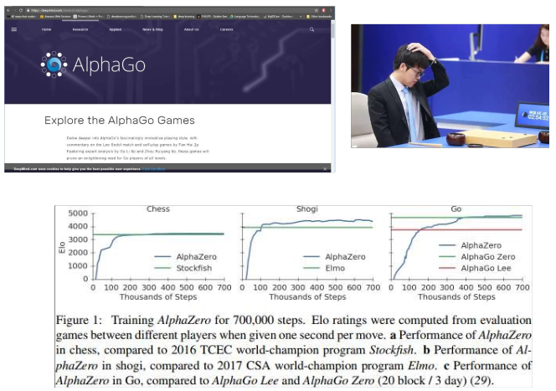
Breakthroughs with Neural Networks
Notes:
In gaming, the DNN out perform the champions. We started with DeepBlue for chess and moved on to AlphaGo.

Slide 25
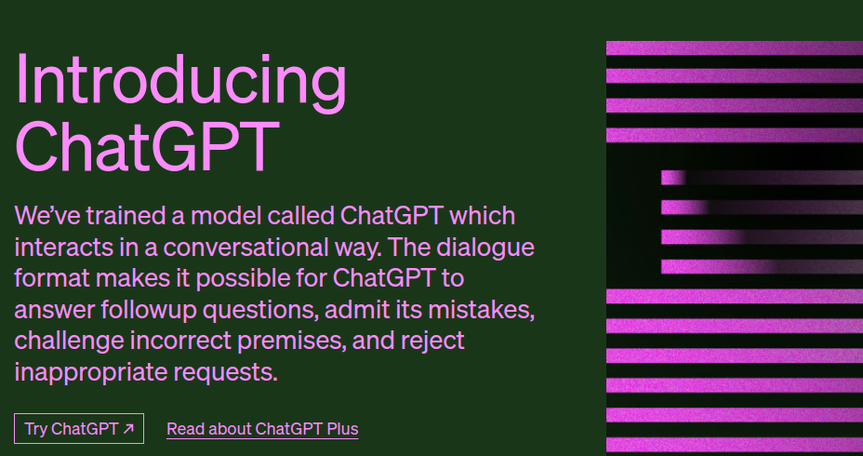
Breakthroughs with Neural Networks
Notes:
Recently Chatgpt making waves using its language models for dialogues.

Slide 26
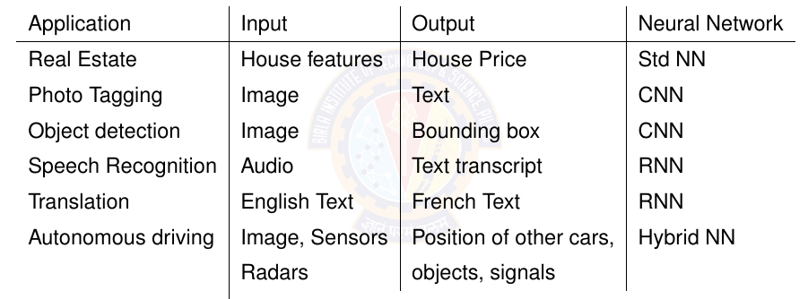
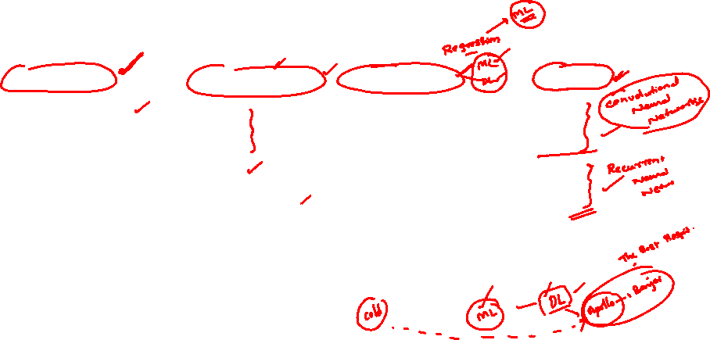
Applications of Deep Learning

Slide 27
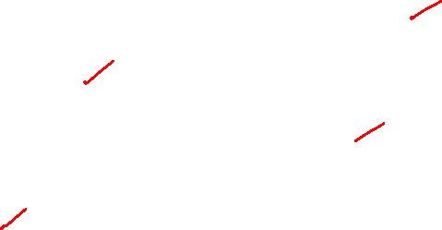
Many more applications….
Predict tomorrowʼs weather given geographic information, satellite images, and a trailing window of past weather.
Takes in a question, expressed in free-form text, and answers it correctly. (Q&A)
Takes in an image and identify all the people it contains, drawing outlines around each. (Object detection)
Presents users with products that they are likely to enjoy but unlikely, in the natural course of browsing, to encounter. (Recommendation systems)
Notes:
Highlight that the input for each of the above are unstructured data like images, text, and web stream clicks. It also involves, looking for a pattern
that changes over time, and we need our programs to adapt. The relationship (say between pixels, and abstract categories) may be too complicated,

Slide 28
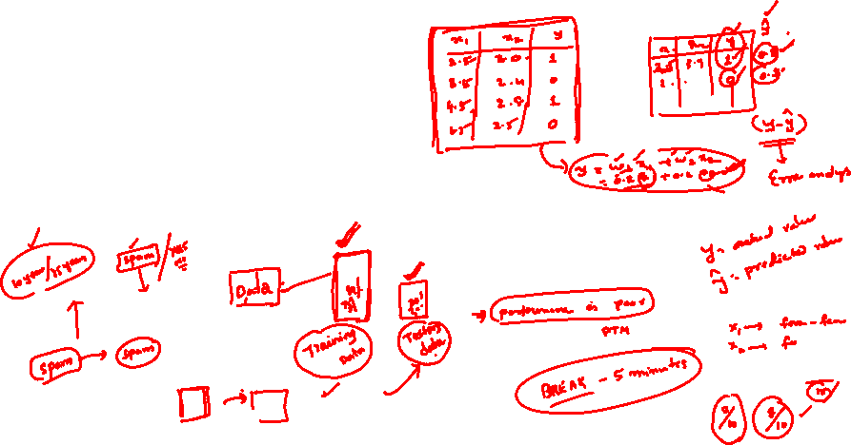
Key components of DL problem

Slide 29
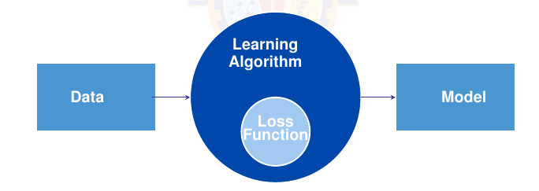
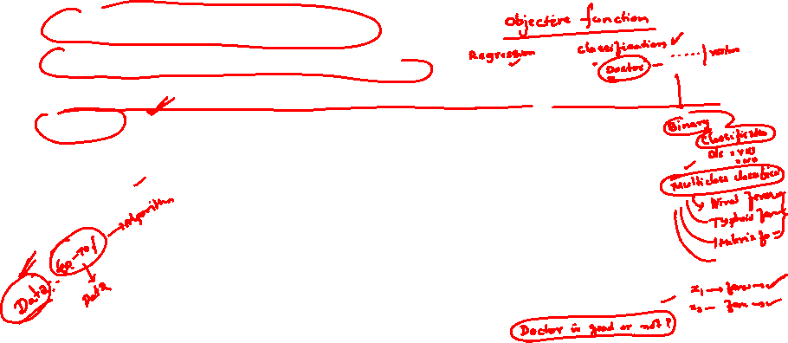
Core components of DL problem
The data that we can learn from.
A model of how to transform the data.
An objective function that quantifies how well (or badly) the model is doing.
An algorithm to adjust the modelʼs parameters to optimize the objective function.
Notes:
Refer to section 1.2. Each point is elaborated in the next slides.

Slide 30

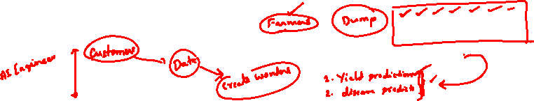
Data
Collection of examples.
Data has to be converted to an useful and a suitable numerical representation.
Each example (or data point, data instance, sample) typically consists of a set of attributes called features (or covariates), from which the model must make its predictions.
In the supervised learning problems, the attribute to be predicted is designated as the label (or target).
Notes:
We need the right data. – The data they handle might include bias (from multiple sources) which the model can capture, this can result in undesired consequences.

Slide 31
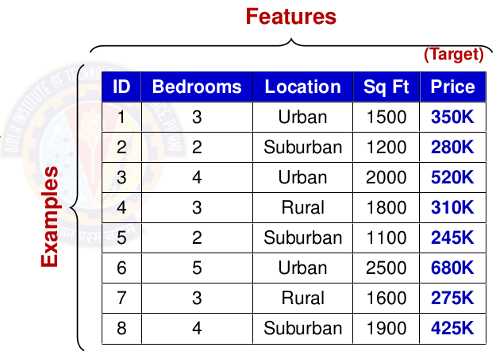

Data
Data = D = {X,t}
Number of features = Number of Dimensions = d
Number of examples = N
As the number of features increase, we say the dimensionality increases.
Notes:
We need the right data. – The data they handle might include bias (from multiple sources) which the model can capture, this can result in undesired consequences.

Slide 32
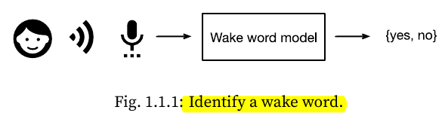
2. Model
Model denotes the computational machinery for ingesting data of one type, and spitting out predictions of a possibly different type.
Deep learning models consist of many successive transformations of the data that are chained together top to bottom, thus the name deep learning.
Notes:
Wake word is Alexa, Hey Siri, Hey Google,
Another example of face recognition where input is image and output is again yes/no. Finger print recognition

Slide 33
3. Objective Function
Learning means improving at some task over time.
Objective functions are formal measures to denote how good (or bad) a mathematical model is.
By convention, objective functions are defined so that lower is better.
Because lower is better, these functions are sometimes called loss functions.
Notes:
You can take any function for which higher is better, and turn it into a new function that is qualitatively identical but for which lower is better by flipping the sign.
squared error is the square of the difference between the prediction and the ground-truth.

Slide 34
4. Learning Algorithms
Learning Algorithm is an algorithm capable of searching for the best possible parameters for minimizing the loss function.
Popular algorithm for deep learning - gradient descent.

Slide 35
Example of the Framework
We have to tell a computer explicitly how to map from inputs to outputs.
We have to define the problem precisely, pinning down the exact nature of the inputs and outputs, and choosing an appropriate model family.
Collect a huge dataset containing examples of audio and label those that do and that do not contain the wake word.

Slide 36
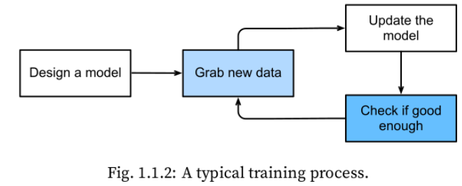
How to Create a Model?
Start with a program whose behavior is determined by a number of parameters.
How to determine the best possible set of parameters? Use data or examples.
Parameters improve the performance of the program with respect to the loss function.

Slide 37
Train the Model
Train the program with data to find the best set of parameters that improves the performance of the program with respect to the loss function.
Once the parameters are finalised, we call the program a model.
    Eg: The model receives a snippet of audio as input, and the model generates a selection among yes / no as output.
The set of all distinct programs (input-output mappings) that we can produce just by manipulating the parameters is called a family of models.
    Eg: Same model family should be suitable for ”Alexa” recognition and ”Hey Siri” recognition because they seem, intuitively, to be similar tasks.

Slide 38
Kinds of Deep Learning Problems

Slide 39
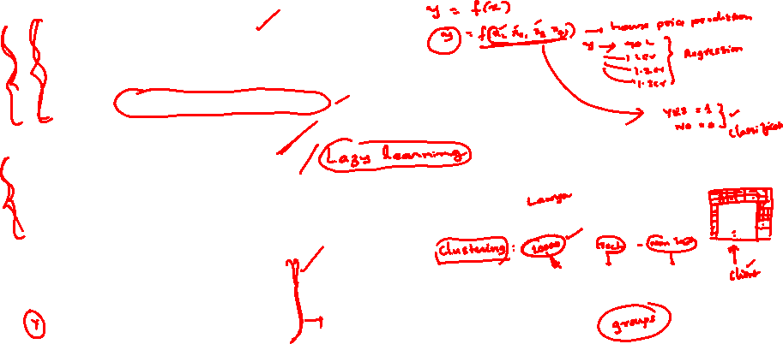
Learning Problems
Supervised Learning
  Training by examples
  The model is given a dataset which has the data and its labels
  Eg: Classification, Regression
  You will learn this in this course and Machine Learning Course
Unsupervised Learning
  Situations where we feed the model a giant dataset containing only the features
  Eg: Clustering, Generate synthetic data (uses GAN)
  You will learn this in Advanced Deep Learning Course and Machine Learning Course
Reinforcement Learning
  Develop an agent that interacts with an environment and takes actions over a series of time steps.
  You will learn this in Deep Reinforcement Learning Course
Notes:
GAN – generative adversarial networks
Supervised learning is explained in the subsequent slides.
Reinforcement Learning is out of scope of this course.

Slide 40
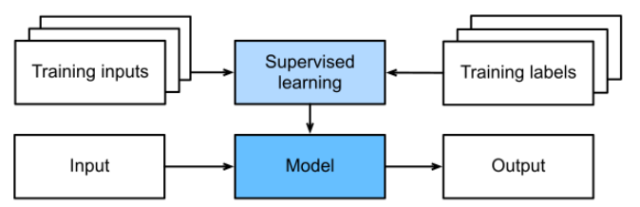
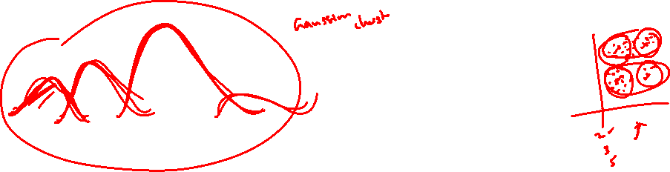
Supervised Learning
Each feature–label pair is called an example.
Goal is to produce a model that maps any input to a label prediction.
The supervision comes into play because for choosing the parameters, we (the supervisors) provide the model with a dataset consisting of labeled examples, where each example is matched with conditional probability of a label given input features.

Slide 41

Supervised Learning Tasks
Regression
  how much or how many question
Classification
  Binary classification
  Multi-class classification
  Multi-label classification
Recommender systems
Sequence Learning
  Tagging and Parsing
  Automatic speech recognition
  Text to speech
  Machine translation

Slide 42

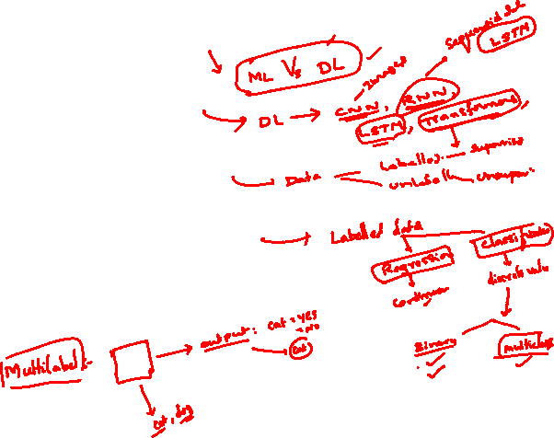
Further Reading
Dive into Deep Learning (T1)
Chapter 1

